Slide 1

FACTORS AFFECTING THE OPIOID PRESCRIPTION RATE
ABHILASH NAUTIYAL
JALAL-U-DIN KADERNANI
PRANJAL DAS

Slide 2

OUTLINE
DATA DESCRIPTION
INTRODUCTION
ANALYSIS
RESULTS
SUMMARY

Slide 3
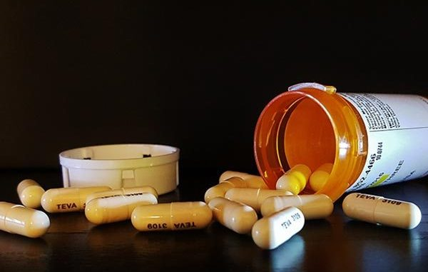
WHAT IS THE PROBLEM ?

Slide 4
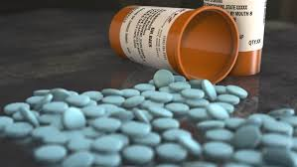
BACKGROUND
44
PEOPLE
Die everyday from overdose
involving opioids prescriptions
Source – www.cdc.gov

Slide 5

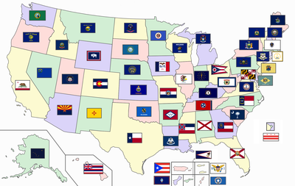


OUR APPROACH
High prescription rate
STATE
PROVIDER
Low prescription rate
Identifying doctors that
over-prescribe opioids
Background
Data Description
Analysis
Summary
Results

Slide 6





STAKEHOLDERS
Background
Data Description
Analysis
Summary
Results

Slide 7

DATA DESCRIPTION
We have taken Medicare Part D Prescribers data available on CMS (Centers for Medicare & Medicaid Services) at https://data.cms.gov/provider-summary-by-type-of-service/medicare-part-d-prescribers/.
The data period is 2020. We selected 10 Million records from the 25 Million CMS dataset.
Target variable is binary & used to predict overprescription (either a prescriber overprescribes 1, or doesn’t 0).
The dataset contains information on Prescriber Details, Beneficiary Claim details
Background
Data Description
Analysis
Summary
Results

Slide 8
DATA DESCRIPTION
We also took state policies data from NAMSDL (National Alliance for Model State Drug Laws) available at https://namsdl.org/wp-content/uploads/Overview-of-State-Pain-Management-and-Prescribing-Policies-1.pdf
Example column in the state policies dataset, prescriber education requirement/statute is present for 23 states in USA and Washington D.C., we have created the binary column ‘Prescriber_Education’ where we put 1 in all the 23 states and DC along with the 10 additional states data provided in the CMS Data. Ex- AA represents Armed Forces in Central/South America.
We have compiled and created columns for 13 state pain management and prescribing polices
Background
Data Description
Analysis
Summary
Results

Slide 9



DATA DESCRIPTION
13 Schedule II and III drugs related policies
15 –Prescriber Type, Prescriber State, NPI, Total claims, Total Drug cost, Specialty, Opioid Presciption Rate etc
Source : NAMSDL
Source : www.cms.gov
Background
Data Description
Analysis
Summary
Results

Slide 10
STATE LEVEL ANALYSIS

Slide 11

ANALYZING OVER-PRESCRIBERS
State
Policies
Binary
CMS data
+
Feature Engineering
Prescriber
Specialty
Classification
FINAL DATASET
Background
Data Description
Analysis
Summary
Results

Slide 12
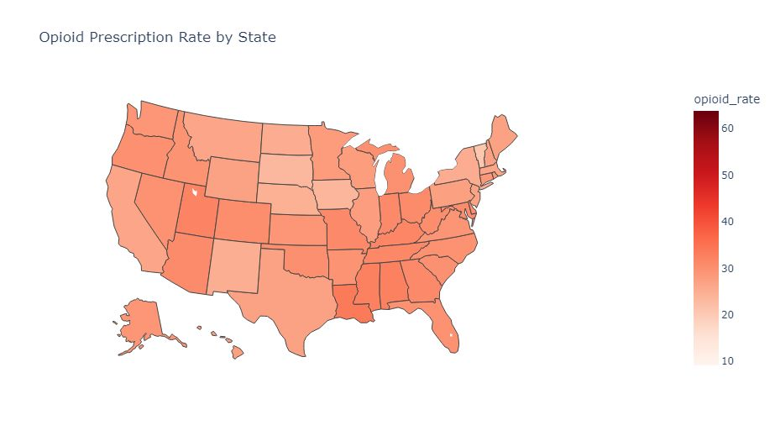
STATE-WISE PRESCRIPTION RATE PER 100 PEOPLE
Background
Data Description
Analysis
Summary

Slide 13
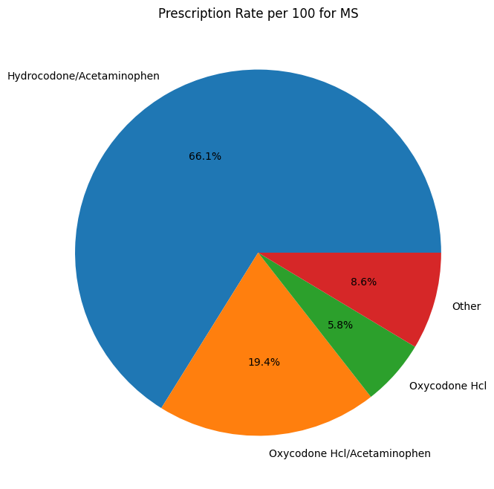
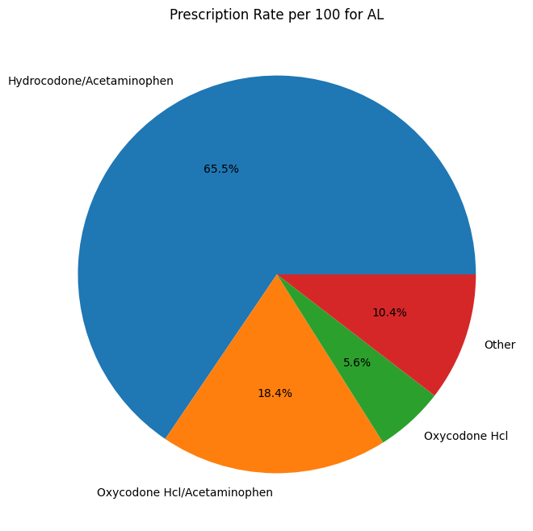
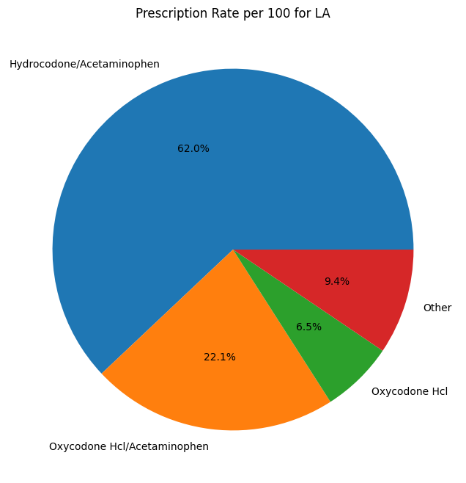
STATE-WISE PRESCRIPTION RATE PER 100 PEOPLE
Top three states where opioid prescription is high
  Louisiana (LA) 33.798023
  Mississippi (MS) 32.588141
  Alabama (AL) 32.482657
Insights considering US Sates (Armed Forces and Foreign states ignored i.e. AA' = 'Armed Forces Central/South America ''AE' = 'Armed Forces Europe ''AP' = 'Armed Forces Pacific' )
Background
Data Description
Analysis
Summary
Results

Slide 14
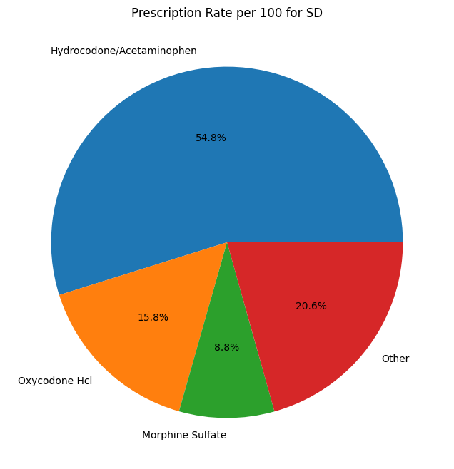
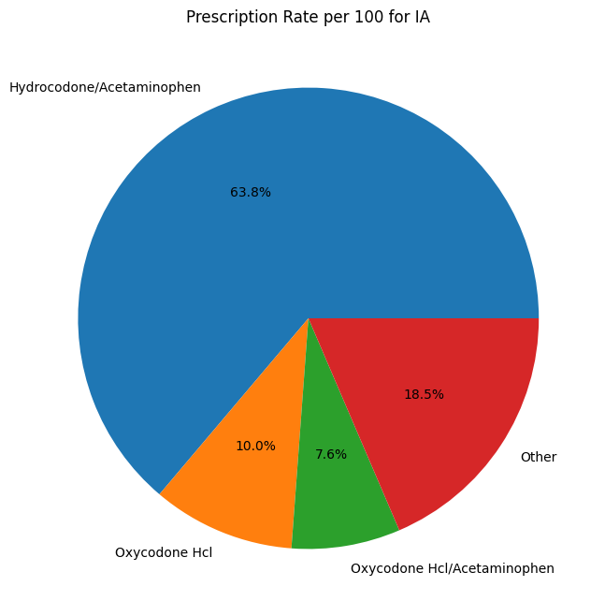
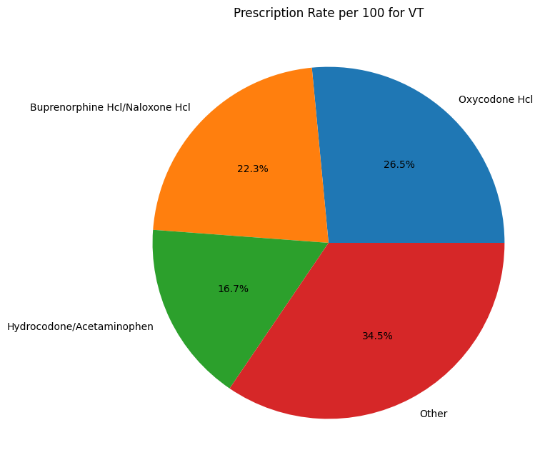
STATE-WISE PRESCRIPTION RATE PER 100 PEOPLE
Three states where opioid prescription is low
  Vermont (VT) 20.799134
  South Dakota (SD) 23.291345
  Iowa (IA) 23.694135
Insights considering US Sates (Armed Forces and Foreign states ignored i.e. AA' = 'Armed Forces Central/South America ''AE' = 'Armed Forces Europe ''AP' = 'Armed Forces Pacific' )
Background
Data Description
Analysis
Summary
Results

Slide 15
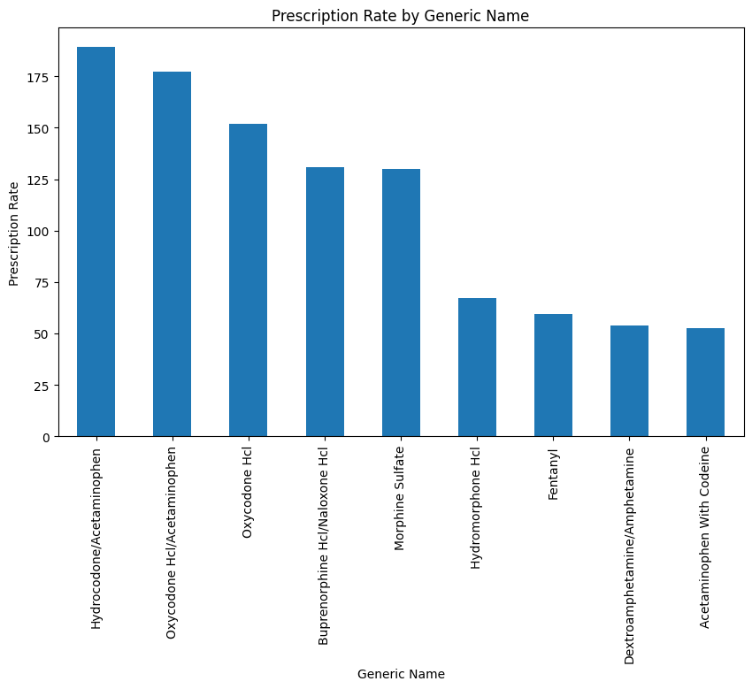
Opioids VS Prescription Rate
Most prescribed Opioids –
Hydrocodone/Acetaminophen
Oxycodone Hcl/Acetaminophen
Background
Data Description
Analysis
Summary
Results

Slide 16
PRESCRIBER SPECIALTY-WISE PRESCRIPTION RATE PER 100 PEOPLE
Top 10 specialties by opioid prescription rate:
Emergency Medical Technician, Basic: 100.00
Behavior Analyst: 100.00
Peripheral Vascular Disease: 100.00
Medical Toxicology: 100.00
Assistant, Podiatric: 100.00
Marriage & Family Therapist: 100.00
Unknown Supplier/Provider Specialty: 100.00
Licensed Practical Nurse: 89.33
Colon & Rectal Surgery: 83.21
Neurological Surgery: 80.72
Bottom 10 specialties by opioid prescription rate:
Pulmonary Disease: 5.95
Health Maintenance Organization: 5.51
Cardiology: 5.42
Gastroenterology: 5.34
Geriatric Medicine: 5.11
Clinic or Group Practice: 3.57
Clinical Neuropsychologist: 1.82
Optometry: 1.32
Interventional Cardiology: 0.69
Advanced Heart Failure and Transplant Cardiology: 0.40

Slide 17


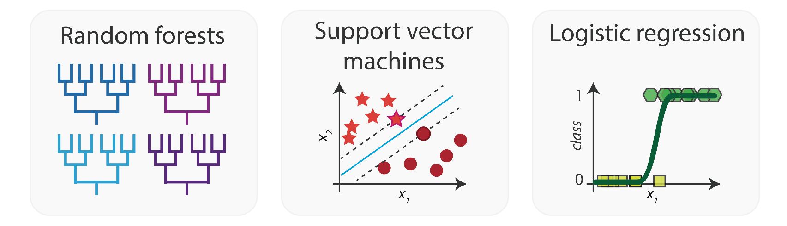
MODEL COMPARISON – TESTING SET ACCURACY
89%
XGBOOST
81%
Random Forest
76%
Logistic Regression

Slide 18
P-Values from Logistic Regression
Tot_Clms | 3.561336E-09
Tot_30day_Fills | 1.252138E-10
Tot_Day_Suply | 1.907308E-14
Tot_Drug_Cst | 4.113806E-01
Tot_Benes | 6.374235E-105
GE65_Tot_Clms | 6.130771E-01
GE65_Tot_30day_Fills | 7.122807E-01
GE65_Tot_Drug_Cst | 5.637086E-03
GE65_Tot_Day_Suply | 3.400646E-09
GE65_Tot_Benes | 1.790741E-11
Classification_Encoded | 3.622327E-02
Prescriber_Education | 1.785961E-02
Day_Supply_Limitation_II | 7.081702E-03
Multiple_Prescriptions | 2.372374E-11
Refill_Restrictions | 2.358059E-01
Day_Supply_Limitation_III | 2.046290E-07
Emergency_Refils_III | 4.658946E-01
Regulate_Pain_Facilities | 3.994023E-19
Written_Informed_Cosent | 9.376349E-03
Fax_Prescriptions | 1.851406E-02
Physical_Information | 3.097683E-01
Specialist_Referral | 6.994706E-03
Written_Treatment_Plan | 4.109944E-05
Expiration_Prescriptions | 3.828293E-03
P-values showing significance of features
State policies which have significant impact on the opioid over prescription rate are Day_Supply_Limitation_II, Multiple_Prescriptions, Day_Supply_Limitation_III, Regulate_Pain_Facilities, Written_Informed_Cosent, Specialist_Referral, Written_Treatment_Plan and Expiration_Prescriptions.

Slide 19
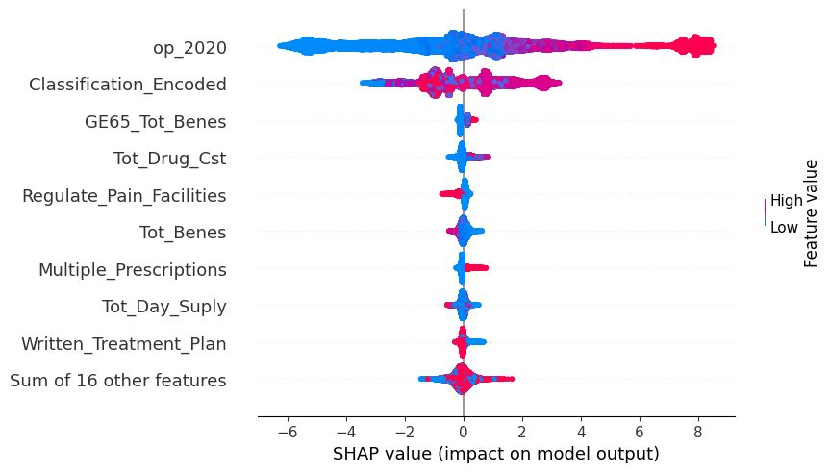
XGBoost – SHAP Analysis
Beeswarm Graph for the final model

Slide 20
STATE FACTORS
STATE OPIOID POLICIES
EFFECT
Fax Prescriptions
5.14%
Regulate Pain Facilities
-2.94%
Multiple Prescriptions
2.70%
Written Treatment Plan
1.85%

Slide 21

FINAL MODEL - ROC

Slide 22

SUMMARY
Predicting over-prescribers of opioids in the US
Using prescriber, patient and state policies data
Interaction of 4 state policies came out to be significant
Prescriber Speciatly type has a significant effect
Background
Data Description
Analysis
Summary
Results

Slide 23
FUTURE STUDY
Prescription limits and refill restrictions: Evaluating the impact of state policies aimed at limiting the number of prescriptions and refills that can be prescribed & identifying strategies to further minimize overprescription.
Prescription drug disposal programs: Evaluating the impact of state policies aimed at promoting safe disposal of prescription medications & identifying strategies for increasing public participation in these programs.
Collaborative care models: Investigating the effectiveness of collaborative care models that involve coordinated efforts between healthcare providers, pharmacists, & patients to promote safe and appropriate use of prescription medications and identifying strategies for improving the implementation and effectiveness of these models.

Slide 24


